Slide 1
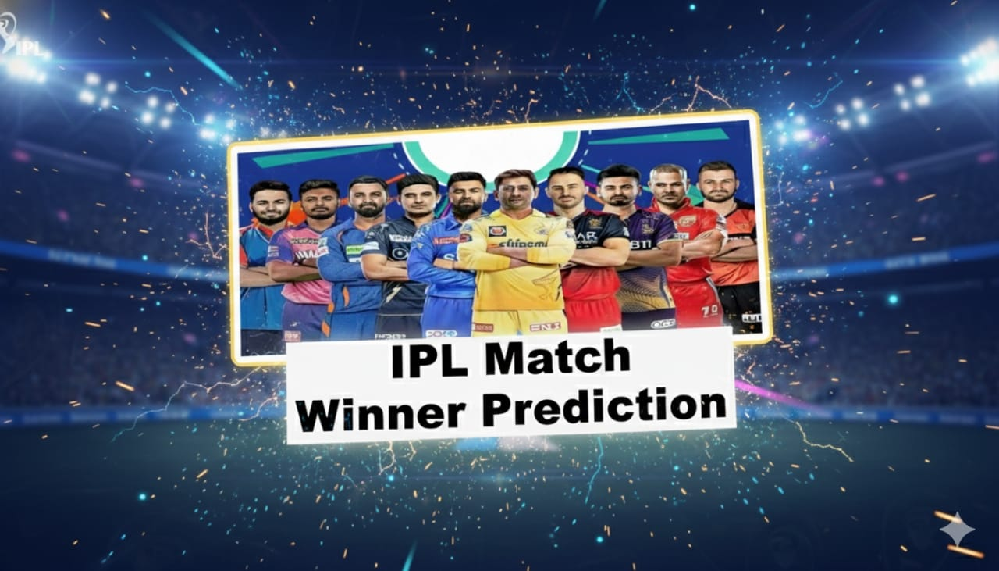
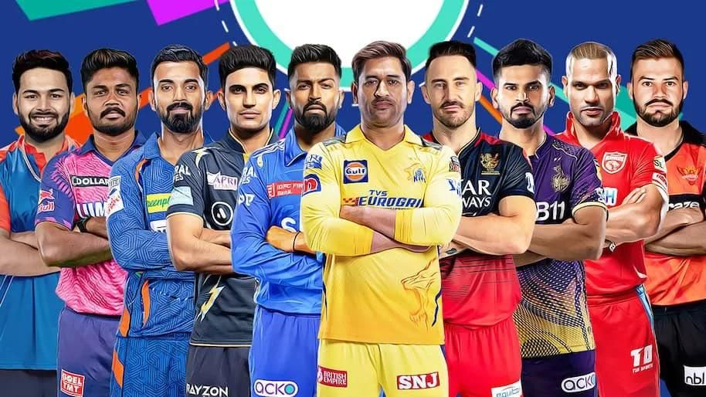

Slide 2

INTRODUCTION
The Indian Premier League (IPL) is one of the world’s most thrilling T20 cricket tournaments.
It brings together top players, exciting matches, and tons of data to analyze.
The IPL dataset captures every match, player performance, and team statistic.
Behind every run, wicket, and toss lies a story hidden in the data.
By analyzing this dataset, we can discover winning patterns, performance trends, and key factors that decide matches.
It’s not just about cricket — it’s about turning raw numbers into insights and predictions!

Slide 3
OBJECTIVES
Perform Exploratory Data Analysis (EDA) on the IPL.
Identify top teams and players based on performance metrics.
Analyze toss impact on match outcomes.
Visualize trends over different seasons.
Derive data-driven insights for strategy and prediction.

Slide 4
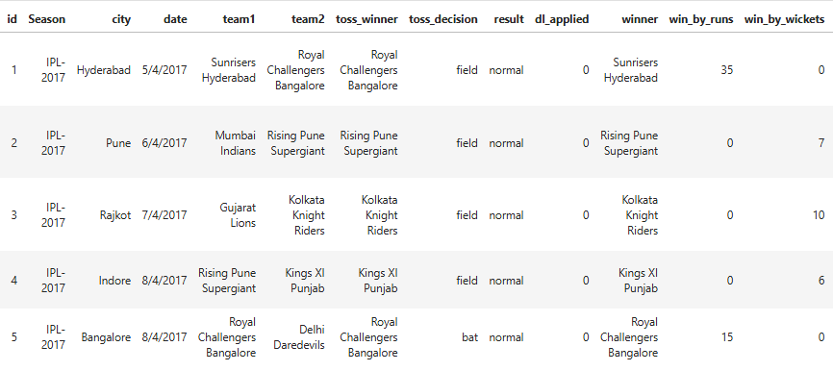
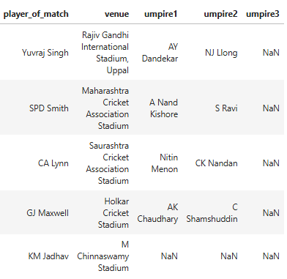
DATASET OVERVIEW
Rows: 765 records
Columns: 18 features

Slide 5
DATA CLEANING
Data cleaning is the process of identifying and correcting errors or missing values in a dataset to ensure it is accurate and ready for analysis.
In my dataset…
Drop id, umpire1, umpire2, umpire3 as it is not useful for analysis.
Extract year from Season and drop Season column.
Replace or rename city and team names correctly.
From date column extract months and drop date column.
Change stadium names because many stadium have different names.

Slide 6
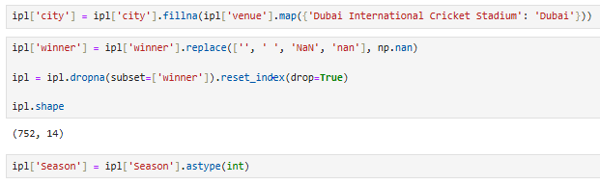
Missing Values Imputation
Fill the city column using venue (using stadium name).
Replace the empty winner column as nan and drop the null value rows.
Change the datatype of season.

Slide 7
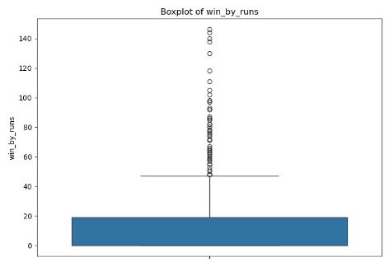
Outlier Treatment
Outliers are data points that differ significantly from other observations in a dataset.
IQR (Interquartile Range) is used to detect and handle outliers in a dataset.
IQR = Q3 – Q1
Q1 → 25th percentile (lower quartile)
Q3 → 75th percentile (upper quartile)
Data points below Q1 – 1.5 × IQR or above Q3 + 1.5 × IQR are considered outliers.
Outliers were not removed because runs differ for each team.

Slide 8
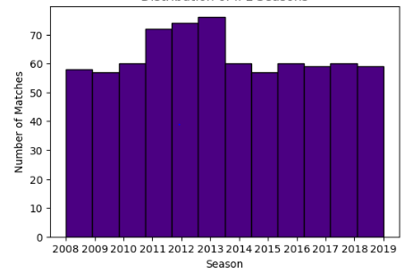
EXPLORATORY DATA ANALYSIS (EDA)
UNIVARIATE ANALYSIS
Distribution of IPL Seasons
2011 saw a notable jump, due to the addition of two new teams (Pune Warriors India and Kochi Tuskers Kerala).
Season 2013 had the highest number of matches (around 76 matches).
From 2014 onward, the number of matches dropped and stabilized around 60 matches per season.

Slide 9
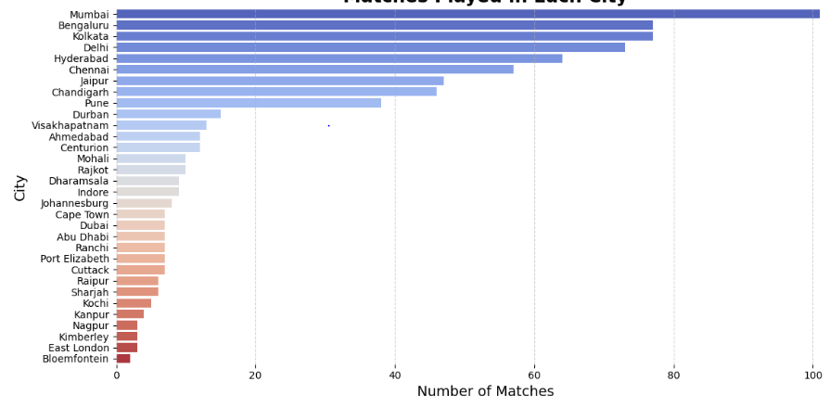
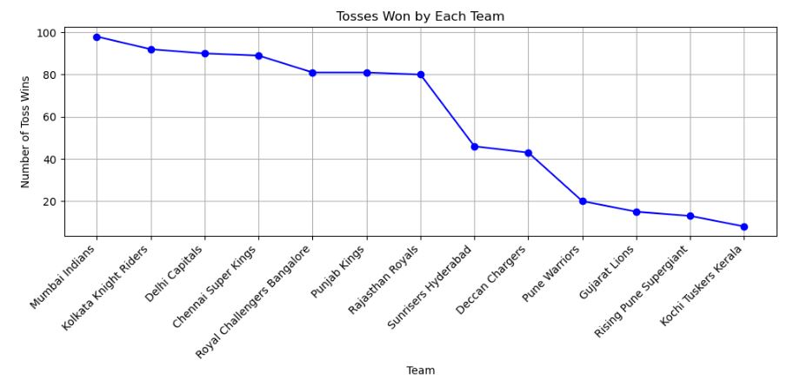
Matches Played in Each City
Mumbai has hosted over 100 matches, making it the top IPL city.
Bengaluru & Kolkata cities Close Behind Mumbai regularly host exciting matches and large crowds.
Tosses Won by Each Team
Mumbai Indians Rule the Toss: With nearly 100 toss wins.
The newer teams like Gujarat Lions, Rising Pune Supergiant, and Kochi Tuskers Kerala haven't been lucky with the toss, with less than 20 toss wins each!

Slide 10
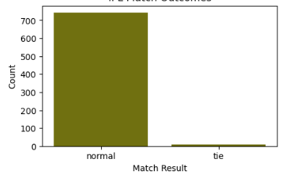
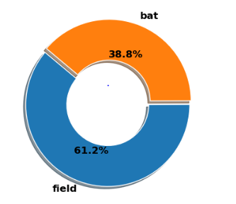
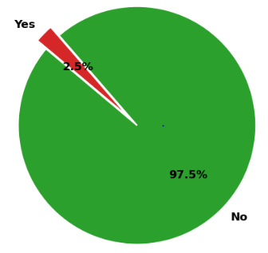
Toss Decision
DL Method Applied
IPL Match Outcomes
in IPL Matches
in IPL Matches
Almost every IPL match ends normally – over 700 games had a clear result.
Ties are extremely rare, just a handful compared to the total.
Most teams prefer to field first – about 61% choose fielding after winning the toss.
Only 39% go for batting first, which shows captains usually like to chase the target.
The DL method was required in only 2.5% of matches, showing IPL games are rarely interrupted.
An enormous 97.5% of games ran without interruptions.

Slide 11
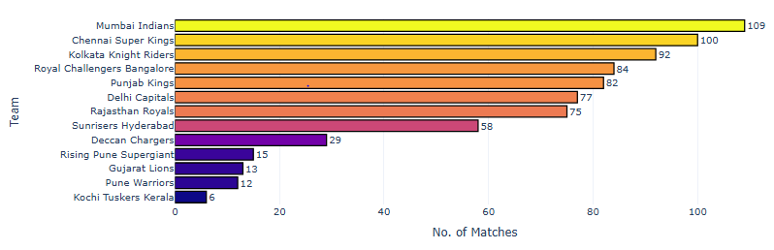
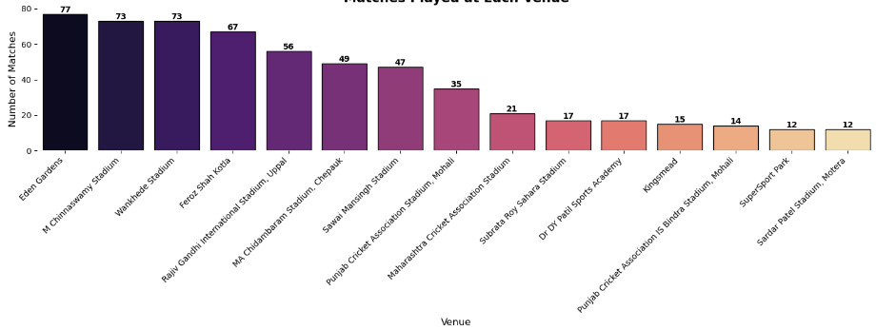
Matches Won by Each Team
Mumbai Indians and Chennai Super Kings are the real powerhouses, winning the most matches and leaving the rest far behind.
There’s a clear “Big Four” with Mumbai, Chennai, Kolkata, and Bangalore, showing the most consistent strength in matches.
Matches Played at Each Venue
M. Chinnaswamy Stadium and Eden Gardens are the busiest stadiums. They've hosted more games than anyone else.
A few other stadiums like Arun Jaitley and Wankhede are also very popular.

Slide 12
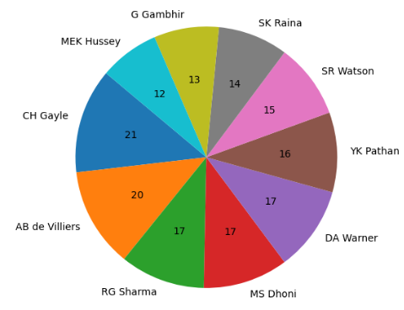
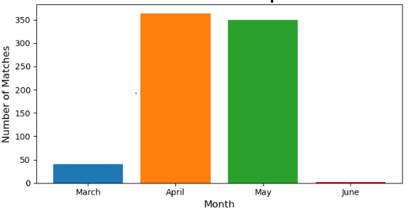
Top 10 Players of the Match
Gayle wins the most! He's the best at getting "Player of the Match."
Four other guys are right behind him – Dhoni, Warner, de Villiers, and RG Sharma all win a lot too.
Everyone on this list is a top player who often helps their team win.
Number of IPL Matches per Month
April & May are Peak Months: Most matches happen then because it's the climax of sports seasons and the weather is good.
Activity drops in June as many leagues enter their off-season or summer break.
Match schedules follow seasons due to weather, league structure and holidays.

Slide 13
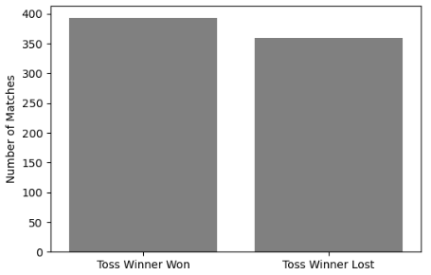
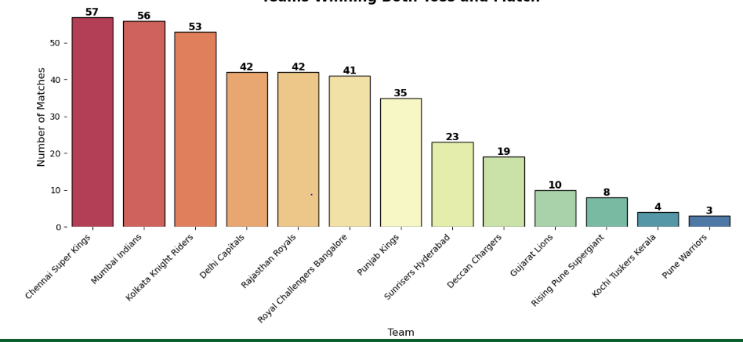
BIVARIATE ANALYSIS
Teams Winning Both Toss and Match
Teams that win the coin toss usually win the game.
But winning the coin toss doesn’t mean you’ll always win; you can still lose a lot of games even if you win the toss.
Chennai & Mumbai : These two teams win the most matches even when they win the toss.
Most teams are pretty close: Many teams sit in the middle with similar toss-win match records

Slide 14
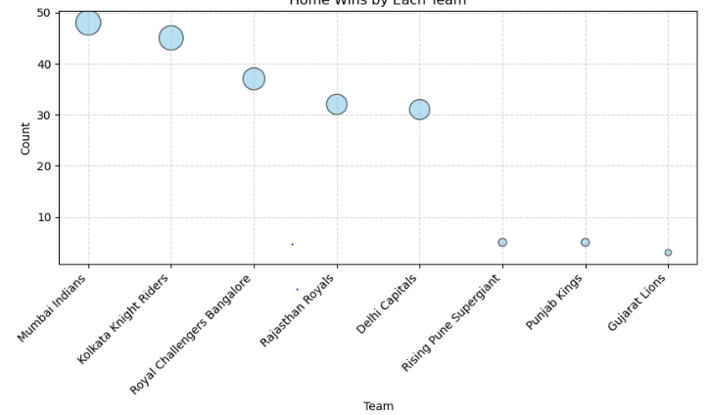
Home Wins by Each Team
Mumbai Indians boast the highest number of home wins near 50, showing their dominant home performance.
Kolkata Knight Riders and Royal Challengers Bangalore follow with both teams securing over 30 home victories.
Rajasthan Royals and Delhi Capitals also performed well, each with home wins exceeding 30.
Rising Pune Supergiant, Punjab Kings, and Gujarat Lions recorded significantly fewer home wins, all under 10.
The bubble size effectively visualizes the win count, making the relative home performance of each team immediately clear.

Slide 15
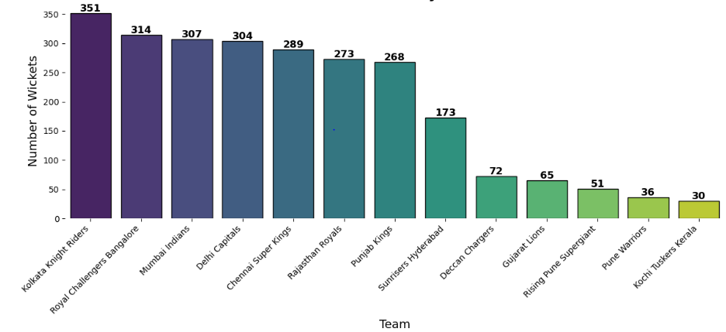
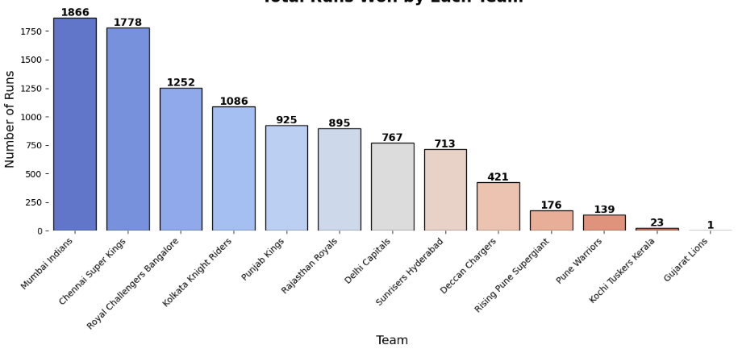
Wickets Won by Each Team
Wicket Warriors: Kolkata Knight Riders stand tall as the ultimate wicket-takers, leading the pack!
Top Contenders: Teams like Mumbai Indians and Chennai Super Kings also show strong wicket-taking performances.
Newer or less successful teams like Kochi Tuskers Kerala lag far behind in wicket counts.
Runs Won by Each Team
Mumbai & Chennai: These two teams are the undeniable kings of run-winning.
The Chasing Pack: RCB and KKR consistently lead the pursuit, but haven't quite matched the top two.

Slide 16
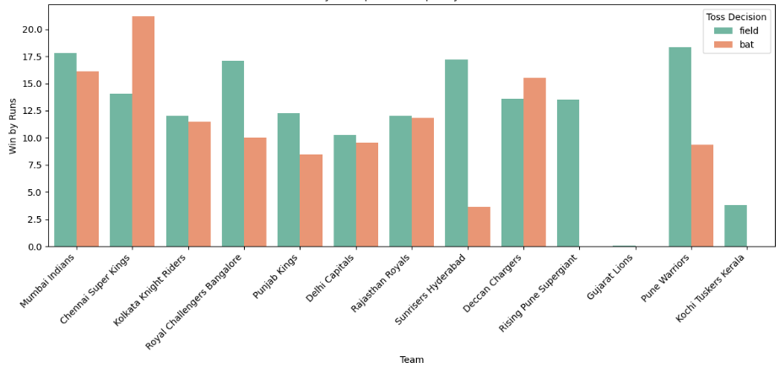
MULTIVARAIATE ANALYSIS
Wins by Runs per Team Split by Toss Decision
Toss Twist: Batting or fielding first matters differently for each team!
CSK Loves Batting First: Chennai Super Kings clearly thrives setting a target.
MI & SRH Field First Favers: Mumbai Indians and Sunrisers Hyderabad shine when chasing.
Not All Teams are Toss-Sensitive: For many, the toss decision has a less clear impact.

Slide 17
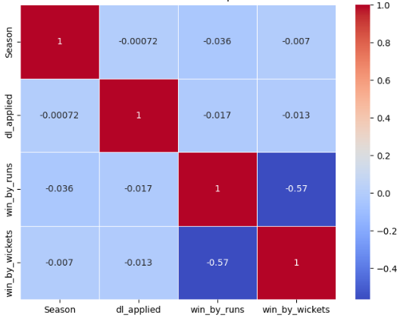
Correlation Heatmap
The correlation heatmap shows that win_by_runs and win_by_wickets are moderately negatively correlated (-0.56), which aligns with cricket rules (a team can either win by runs or by wickets, but not both).
The dl_applied feature has negligible correlation with both, suggesting it independently affects match outcomes without directly influencing the margin of victory.

Slide 18
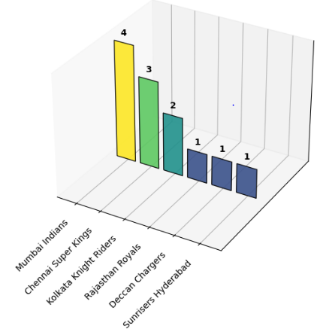
IPL Trophies Won by Each Teams
Mumbai and Chennai: The IPL Kings! They've won the most trophies by far.
It's a Two-Team Show: Mumbai Indians and Chennai Super Kings dominate, grabbing almost 60% of all titles shown.
Kolkata's Strong Presence: Kolkata Knight Riders are a clear third in terms of wins.
Other Champions: Rajasthan, Deccan, and Hyderabad each have one title under their belt in this chart.

Slide 19
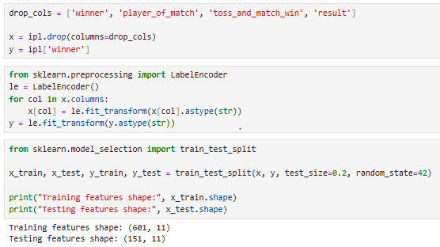
DATA PREPROCESSING
Dropping Irrelevant Columns.
Encoding Categorical Variables.
Splitting Data into Training and Testing Sets

Slide 20
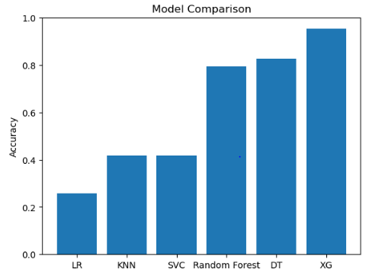
MODEL TRAINING
After preprocessing, machine learning models were trained to predict the match winner.
Each model was trained using the training set and evaluated on the testing set.
Six machine learning models were trained and evaluated: Logistic Regression, SVC, Random Forest, Decision Tree, KNN, and XGBoost.
Model | Accuracy
Logistic Regression | 0.25
SVC | 0.41
Random Forest | 0.79
Decision Tree | 0.82
KNN | 0.41
XGBoost | 0.95

Slide 21
HYPERPARAMETER TUNING
To improve model performance beyond the default parameters, GridSearchCV was used to perform hyperparameter tuning.
Each model was optimized with respect to important hyperparameters, and the results were compared with baseline models.
Model | Accuracy
Logistic Regression | 0.27
SVC | 0.54
Random Forest | 0.80
Decision Tree | 0.95
KNN | 0.54
XGBoost | 0.98
• Hyperparameter tuning improved model performance compared to default values.
• XGBoost achieved the highest accuracy after tuning, followed by Decision Tree.
• Simpler models like Logistic Regression and KNN showed lower improvements.

Slide 22
Conclusion
The analysis of the IPL dataset reveals that team performance is influenced by factors such as toss results, venue, and individual player contributions.
By studying trends across seasons, we can understand the evolution of teams, player efficiency, and match-winning patterns.
Such data-driven insights can support better team selection, performance evaluation, and strategic planning for future IPL seasons.

